Slide 1
Commonwealth of Virginia
2018 Open Enrollment
Health Care and
Flexible Spending Accounts (FSAs)
May 1-15, 2018
Notes:
It’s time again for annual Open Enrollment. 2017 Open Enrollment for Health Care and Flexible Spending Accounts starts May one and ends May 15, 2017.
In this presentation, we’ll talk about your available plans and choices during Open Enrollment, benefit changes for July 1, earning a Premium Reward for the new plan year and flexible spending accounts.

Slide 2
Your Time to Choose
It’s the annual window for you to make decisions on health care and flexible spending accounts (FSAs)
Nothing is required if you are:
Not changing your health plan,
Not enrolling in an FSA, and
Not participating in Premium Rewards
April 2018
2

Slide 3
Health Care Coverage
Enroll in or change your health plan
Elect or remove optional buy-ups for COVA Care, COVA HDHP and COVA HealthAware
Waive coverage
Add or remove family members
April 2018
3
Notes:
Think through your options carefully before you decide to make changes during Open Enrollment. Remember, after May 15, your Open Enrollment election cannot be changed. Consider what your family’s health care needs may be in the next year.
You can enroll or change your health plan. Or you can always keep your current plan . You may also want to consider adding or dropping optional buy-ups for COVA Care, the COVA High Deductible Health Plan, or HDHP, and COVA HealthAware. These can be purchased for an additional premium. You also have the choice to waive coverage in state health benefits.
Think about adding or removing family members from your coverage. It’s important to remember that if you add a family member, you will need to submit proper documentation to your benefits office. And also keep in mind that if you enroll or fail to remove an ineligible family member, you can face disciplinary action or be removed from the health benefits program for up to three years.
In addition to health care, you can enroll in a Flexible Spending Account, or F-S-A during Open Enrollment. There are two accounts: Health and Dependent Care. You can enroll in one or in both accounts. Remember that you must enroll every year to have an FSA.

Slide 4
Flexible Spending Accounts (FSAs)
Enroll in a Health or Dependent Care FSA or both
You must submit an enrollment request every year you wish to have an FSA
April 2018
4

Slide 5
How to Enroll or Make Changes
EmployeeDirect remains unavailable for Health Benefits
You must submit an Enrollment Form to your agency Benefits Administrator
The deadline is the close of business on May 15, 2018
April 2018
5

Slide 6
Complete an Enrollment Form
Enroll in an FSA
See Section 3 of the form
Enter your “per pay” election amount for your requested account
Health FSA – for eligible out-of-pocket medical expenses
Dependent Care FSA – for a provider to care for your child or disabled adult dependent
Enrolling in an FSA and don’t want health care changes?
Just mark the “No Change” block in Section 4
April 2018
6

Slide 7
Complete an Enrollment Form
Your Health Coverage
See Section 4 of the form
Enroll or make changes to your health care coverage
Complete Part A – Your health plan choice
Complete Part B – Family members to be covered
Don’t want health care changes?
Just mark the “No Change” block in Section 4
April 2018
7

Slide 8
Submit Your Enrollment Form
Find the fillable form on the DHRM website
http://www.dhrm.virginia.gov/healthcoverage/ open-enrollment
No computer access?
Request a printed enrollment form from your Benefits Administrator
Complete it, print, sign and submit to your Benefits Administrator
April 2018
8
Notes:
Think through your options carefully before you decide to make changes during Open Enrollment. Remember, after May 23rd, your Open Enrollment election cannot be changed. Consider what your family’s health care needs may be in the next year.
You can enroll or change your health plan. Or you can always keep your current plan . You may also want to consider optional buy-ups for COVA Care, the COVA High Deductible Health Plan, or HDHP, and COVA HealthAware. These can be purchased for an additional premium. You also have the choice to waive coverage in state health benefits.
Think about adding or removing family members from your coverage. It’s important to remember that if you add a family member, you will need to submit proper documentation to your benefits office. And also keep in mind that if you enroll or fail to remove an ineligible family member, you can face disciplinary action or be removed from the health benefits program for up to three years.
In addition to health care, you can enroll in a Flexible Spending Account, or F-S-A during Open Enrollment. There are two accounts: Health and Dependent Care. You can enroll in one or in both accounts. Remember that you must enroll every year to have an FSA.

Slide 9
Your Health Plan Options
Plans Offered | Administrator | Available
COVA HealthAware | Aetna | Statewide
COVA Care | Anthem Blue Cross and Blue Shield Delta Dental of Virginia | Statewide
COVA HDHP | Anthem Blue Cross and Blue Shield Delta Dental of Virginia | Statewide
Kaiser Permanente HMO | Kaiser Permanente | Regional, primarily in Northern Virginia
TRICARE Supplement | Selman & Company | Statewide
April 2018
Notes:
You have a menu of health plans available to you.
COVA HealthAware is offered statewide and Aetna administers all benefits.
COVA Care and COVA HDHP are also statewide plans administered by Anthem Blue Cross and Blue Shield, and Delta Dental of Virginia.
The Kaiser Permanente HMO is a regional plan offered primarily in Northern Virginia. The statewide TRICARE supplement coordinates with the federal TRICARE plan and is administered by Selman & Company.

Slide 10
What’s Changing for 7/1/2018?
Premiums change – see Spotlight
Governor’s health initiatives – more information coming before or during the new plan year
COVA Care and COVA HDHP
Annual routine vision exam:
$15 copayment at a participating Blue View provider
Discounts on lenses and frames from a participating Blue View provider
COVA Care, COVA HDHP, COVA HealthAware and Kaiser Permanente HMO
Hormonal contraceptives dispensing limit increased: A 12-month supply will be available at one time
April 2018
Notes:
Let’s talk about changes coming July 1. Be sure to take a look at the monthly premiums.
All state employee and non-Medicare eligible retiree health benefits plans will comply with ACA Section 1557, Nondiscrimination in Health Programs and Activities. For COVA Care and COVA H-D-H-P members, LiveHealth Online has added Psychology and EAP services.
COVA Care and COVA HealthAware participants can earn a Premium Reward by completing a health assessment. More on that is coming up.

Slide 11
Put ALEX to Work for You!
Give ALEX a try!
Review your health plan options with ALEX
He’ll use your input, do the math, and recommend a plan just for you
www.myalex.com/cova/2018
April 2018
11
Notes:
Your online benefits counselor is here to help! ALEX can walk you through your health plan options. He’ll use your input to advise you on how the plans work for you.
Visit ALEX at www.myalex.com/cova/2017.
Remember, even with ALEX’s advice, you make the final decision on a plan.

Slide 12
Earn Premium Rewards!
For employee, retiree and/or spouse enrolled in COVA Care or COVA HealthAware
Employee, retiree or spouse can save $17/month
Together can save $34/month
April 2018
Notes:
If you enroll in COVA Care or COVA HealthAware, you can earn a
premium reward to reduce your premium every month AND help you get on the road to better health.
Employees, retirees and/or their enrolled spouses enrolled in COVA Care or COVA HealthAware are eligible for a premium reward. As an employee, retiree or spouse, you can save $17 a month, or up to $204 annually . And together, participants and spouses can save $34 a month, or up to $408 a year.

Slide 13
What Do I Need to Do?
Be enrolled in COVA Care or COVA HealthAware
For a Reward Starting July 1
Complete or update your health
assessment between May 1 and May 15
For a Reward After July 1
Complete a health assessment by the
15th of any month to receive a reward in about six to eight weeks
See PR requirements chart: www.dhrm.virginia.gov/healthcoverage/open-enrollment
Questions?
Ask your Benefits Administrator
www.myactivehealth.com/cova
1-866-938-0349
April 2018
Notes:
To earn a Premium Reward effective July 1, 2017, you must be enrolled in COVA Care or COVA HealthAware.
Between May 1 and May 15, 2017, you need to complete or update your health assessment at www.myactivehealth.com/cova to earn your reward.
An employee or spouse who is not enrolled in a state health plan will need to call the toll-free number to complete the assessment.
Remember, if you are eligible you can complete the health assessment at any time! And if you complete it by the 15th of the month, you will receive a reward in about six to eight weeks.
There’s a helpful chart showing when your Premium Reward will be effective based on when you complete the assessment. It’s on the Open Enrollment page at the Premium Rewards Requirement link here: www.dhrm.virginia.gov/healthcoverage/open-enrollment

Slide 14
Administered
by
Anthem
The basic plans include:
Medical
Behavioral Health
Employee Assistance Program (EAP)
Prescription Drug
Diagnostic and Preventive Dental (administered by Delta Dental of Virginia)
April 2018
Notes:
For COVA Care and COVA HDHP, Anthem administers medical benefits, behavioral health and an Employee Assistance Program, or E-A-P, as well as a prescription drug program. Delta Dental partners with Anthem for diagnostic and preventive dental benefits.
Anthem has a wide ranging BlueCard network for coverage in the U.S. and abroad at the in-network level. The international network that was formerly BlueCare Worldwide is now called the Blue Cross Blue Shield Global Core Program.
For both plans, in-network preventive care is covered at 100 percent with no copay or coinsurance. For COVA Care, you pay copayments for most services. There are some services with coinsurance after you pay a deductible. For COVA HDHP, you meet a deductible and then pay coinsurance. And you may also set up a Health Savings Account, or H-S-A, on your own through your financial institution to help you pay for out-of-pocket expenses with tax-deductible funds.
To get more information on these plans, visit www.anthem.com/cova.

Slide 15
Administered
by
Anthem
New! Annual routine vision exam and services in the basic plans
From a participating Blue View provider
$15 copayment for your annual routine vision exam
$50 - $105 copayment on plastic lenses
15% discount on non-disposable contact lenses, and
20-35% discount on frames
From a non-Blue View provider
Plan pays $30 and you pay the balance
April 2018
Notes:
For COVA Care and COVA HDHP, Anthem administers medical benefits, behavioral health and an Employee Assistance Program, or E-A-P, as well as a prescription drug program. Delta Dental partners with Anthem for diagnostic and preventive dental benefits.
Anthem has a wide ranging BlueCard network for coverage in the U.S. and abroad at the in-network level. The international network that was formerly BlueCare Worldwide is now called the Blue Cross Blue Shield Global Core Program.
For both plans, in-network preventive care is covered at 100 percent with no copay or coinsurance. For COVA Care, you pay copayments for most services. There are some services with coinsurance after you pay a deductible. For COVA HDHP, you meet a deductible and then pay coinsurance. And you may also set up a Health Savings Account, or H-S-A, on your own through your financial institution to help you pay for out-of-pocket expenses with tax-deductible funds.
To get more information on these plans, visit www.anthem.com/cova.

Slide 16
Optional Benefits
Expanded Dental
Routine Vision/Hearing
Out-of-Network
Expanded Dental
April 2018
Notes:
Under COVA Care, there are three optional benefits available for an additional monthly premium – expanded dental, routine vision and hearing, and out-of-network.
COVA H-D-H-P offers expanded dental benefits. While you can purchase out-of-network coverage for COVA Care, there is no out-of-network coverage for COVA HDHP.

Slide 17
Expanded Dental
Delta Dental of Virginia administers dental benefits
Expanded Dental option
Primary Care – such as fillings, extractions, root canals
Complex Restorative - crowns, dentures, bridges and implants
Orthodontic services
April 2018
Notes:
Delta Dental administers dental benefits for COVA Care and COVA HDHP.
These plans automatically include basic dental services with 100% coverage for diagnostic and preventive services such as routine exams and cleanings, as well as sealants and fluoride for children. These services are not subject to the deductible and the annual $2,000 maximum.
If you need additional dental coverage beyond what is provided in the COVA Care or COVA HDHP basic plan, you can purchase the Expanded Dental option. You pay an individual deductible of $50. Once the deductible is met, the plan covers primary services like fillings, extractions and root canals at 80 percent, and complex restorative services like crowns and dentures at 50 percent. There is a $2,000 plan year maximum. Expanded dental also includes coverage for orthodontia at 50 percent, with a lifetime maximum of $2,000.
You may receive care for dental services outside of the network. Just remember that balance billing may apply.
If you have questions, call Delta Dental customer service.

Slide 18
Vision and Hearing
Blue View Vision
Eyeglasses
Contact lenses
Includes allowances for non-Blue View provider services
Hearing
Routine hearing exam once per plan year
Hearing aids and related supplies up to $1,200 every 48 months
April 2018
◦
◦
Notes:
If you have Expanded Dental coverage with COVA Care, you may also purchase an optional buy-up to cover vision and hearing benefits. Remember that vision services related to medical conditions are covered in the basic plan.
Covered vision services through the Blue View Vision network include your annual routine eye exam, eyeglasses, contact lenses, and discounts on eyewear accessories.
The Hearing portion of the buy-up includes a routine hearing exam which will be covered once per plan year. Hearing aids and other hearing-aid related services are covered every 48 months up to a $1,200 limit.

Slide 19
Out-of-Network
Plan payment reduced by 25%
Provider may balance bill for amounts the plan doesn’t pay
April 2018
Notes:
The COVA Care out-of-network-option pays for covered services received outside the network at the in-network level less a 25% reduction in the amount paid by your plan. The provider may balance bill for any amounts that the plan doesn’t pay.
You may want to consider this option if you want to see a provider who is not in the Anthem PPO or the BlueCard PPO network for care in the U.S.

Slide 20
LiveHealth Online
Make an appointment for a doctor’s visit, or with a licensed therapist or psychiatrist (new!)
Schedule online or call 1-844-784-8409
New! COVA Care visits are $0
Use your Employee Assistance Program (EAP) to see a counselor at no cost
Call 1-855-223-9277 to get your coupon code and details on making your first appointment
April 2018
www.livehealthonline.com
◦
◦
Notes:
There’s something new at LiveHealth Online. LiveHealth Online Psychology and the Employee Assistance Program (EAP) have been added to services at your online doctor.
You can make an appointment with a licensed therapist at the same cost as an outpatient behavioral health visit.
You can also use your EAP to see a counselor online at no cost to you.

Slide 21
Administered by Aetna
The basic plan includes:
Medical
Behavioral Health and EAP
Prescription Drug
Routine Vision and Hearing Exams
Diagnostic and Preventive Dental Services
Health Reimbursement Arrangement (HRA)
Out-of-Network Coverage
April 2018
◦
◦
Notes:
Let’s take a look at the COVA HealthAware statewide plan administered by Aetna.
COVA HealthAware is a comprehensive consumer-driven health plan.
The COVA HealthAware basic plan includes coverage for all of the major health benefits provided by the Commonwealth, as well as a few extras. Those include annual routine vision and hearing exams, diagnostic and preventive dental services and out-of-network coverage, at no additional cost to you. COVA HealthAware also includes a Health Reimbursement Arrangement, or H-R-A, to help you pay certain out-of-pocket costs.

Slide 22
What is a Health Reimbursement Arrangement (HRA)?
Account that automatically pays eligible out-of-pocket expenses as long as funds are available
Medical
Behavioral health
Pharmacy
Funds paid from HRA toward eligible expenses for any covered member
Unused HRA funds roll over into future plan years with no limit if enrollment in the plan continues
April 2018
◦
◦
Notes:
Members can use Health Reimbursement Arrangement, or H-R-A, funds to pay for out-of-pocket medical, behavioral health and pharmacy costs. The best part is that this all happens automatically when the claim is processed. And it’s important to know that expenses paid by the H-R-A count toward the annual deductible and out-of-pocket maximum.
If funds remain in the H-R-A at the end of the plan year, they roll over into the following plan year, as long as the member stays in the plan.
And Aetna helps you keep track of the H-R-A with online tools that can be accessed 24/7. You can find more information on these tools by calling the Aetna concierge line at 855-414-1901 or by visiting www.covahealthaware.com.

Slide 23
HRA Contribution
Initial HRA contribution for 7/1/2018:
Employee/Retiree - $600
Employee/Retiree + Spouse - $1,200
HRA contribution is prorated for new enrollments or QME changes during the plan year.
The HRA proration chart may be found at www.COVAHealthAware.com
April 2018
◦
◦
Notes:
At the beginning of the plan year, an individual employee or retiree will have a new $600 contribution in their H-R-A. If they cover a spouse, the amount will be $1,200 for the participant and their spouse. This will be in addition to any funds rolled over from the previous year.
Remember that you can use funds from the H-R-A to help pay out-of-pocket expenses for all covered family members.
It’s also important to note that the H-R-A is prorated for employees or retirees who enroll in COVA HealthAware after July 1 and members who have certain Qualifying Mid-Year Events during the plan year. More information about that can be found at www.COVAHealthAware.com

Slide 24
How the Plan Works
 | In-Network | Out-of-Network
Deductible
One person | $1,500 | $3,000
Two or more persons | $3,000 | $6,000
Out-of-Pocket Max
One person | $3,000 | $6,000
Two or more persons | $6,000 | $12,000
HRA Contribution
Employee/Retiree Only | $600
Employee/Retiree + Spouse | $1,200
April 2018
◦
◦
Notes:
COVA HealthAware uses Aetna’s comprehensive, nationwide provider network.
In-network preventive care is covered at 100 percent. For other in-network services, you first meet an annual deductible. Then the plan pays 80 percent and you pay 20 percent. The plan continues to pay 80 percent until you reach your out of pocket max, at which point the plan pays 100% of eligible expenses for the rest of the plan year.
Out-of-network coverage is provided as part of the standard plan, but your out-of-pocket costs are more. You have to satisfy a higher deductible, and then the plan pays 60 percent and you pay 40 percent. Balance billing may apply.

Slide 25
HRA “Do Rights”
Employees/Early Retirees and enrolled spouses
$50 HRA contribution for up to three “Do Rights”
Up to $150 per employee/early retiree
Up to $150 per enrolled spouse
“Do Rights”
Annual routine physical exam
Routine dental exam
Annual routine vision exam
Annual flu shot
MyActiveHealth Health Tracker
MyActiveHealth Coaching Module
April 2018
◦
◦
Notes:
Eligible members can get extra contributions to their HRA by taking healthy actions that are called “do rights.” They include getting an annual physical exam, a routine dental exam, annual routine vision exam, annual flu shot, or using the MyActiveHealth coaching module or health tracker.
Let’s talk more about the Do Rights. An employee, retiree and/or their enrolled spouses can earn an additional $50 per “do right” for their H-R-A up to a total of $150. If the employee or retiree and their enrolled spouse both participate, together they can earn up to $300. Under the COVA HealthAware plan, it pays to be healthy!

Slide 26
Optional Benefits
Expanded Vision
Eyeglasses
Contact lenses
Discounts for eyewear and accessories
Network includes private practice providers plus participating national chains
Expanded Dental
Primary Care – such as fillings, extractions, root canals
Complex Restorative - crowns, dentures, bridges and implants
Orthodontic services
April 2018
◦
◦
Notes:
The COVA HealthAware plan has two optional benefits. You can purchase Expanded Dental, or Expanded Dental and Expanded Vision together at an extra cost.
If you need additional dental coverage beyond what is provided in the COVA HealthAware basic plan, you can purchase the Expanded Dental option. You pay an individual deductible of $50. Once the deductible is met, the plan covers primary services like fillings, extractions and root canals at 80 percent, and complex restorative services like crowns and dentures at 50 percent. There is a $2,000 plan year maximum. Expanded dental also includes coverage for orthodontia at 50 percent, with a lifetime maximum of $2,000.
You may receive care for dental services outside of the network. Just remember that balance billing may apply.
While you receive an annual eye exam under the basic COVA HealthAware plan, you can also purchase expanded vision. This includes an annual allowance toward the purchase of eyeglasses, contact lenses, and also access to discounts on other vision services.

Slide 27
Teladoc – Your Online Doctor
24/7 access to a doctor from smartphone,
tablet or computer
www.Teladoc.com or call 855-Teladoc
April 2018
◦
◦
Notes:
These three plans also have an online doctor for your convenience!
LiveHealth Online for COVA Care and COVA HDHP, lets you consult with a doctor anytime, day or night, from your smartphone, tablet, or computer with a web cam. Just download the LiveHealth Online app or sign up at livehealthonline.com. Choose from a broad network of U.S. board-certified doctors who average 15 years of experience practicing medicine and are specially trained for online visits. The cost for a visit is $25 under the COVA Care plan – the same as a PCP visit. It’s $49 under COVA H-D-H-P before meeting the plan year deductible, then 20% coinsurance once the deductible is met.
COVA HealthAware members have Teladoc - 24/7/365 access to U.S. board-certified doctors and pediatricians who can diagnose and recommend treatment by phone or online video, and prescribe medications — all for less than a traditional doctor’s visit! You pay $40 per consultation, which applies to your deductible and can be paid from your HRA. When the deductible has been met, you pay 20 percent coinsurance. Visit www.teladoc.com/aetna or call 1-855-Teladoc to learn more, set up an account or request a consultation.

Slide 28
Employee Assistance Program (EAP)
Up to 4 visits per issue each plan year at no cost to member
For participants and members of their household
Confidential resource for personal and workplace challenges
Legal and financial guidance
www.AnthemEAP.com
www.mylifevalues.com
April 2018
◦
◦
Notes:
The COVA Care, COVA HDHP and COVA HealthAware plans include an important benefit for your well-being – the Employee Assistance Program, or E-A-P.
Each plan year, the E-A-P provides up to 4 visits of free counseling per issue for members and those living in their household. It addresses behavioral health and workplace issues, parenting and child care and other topics that apply to work and life balance.
For COVA Care and COVA HDHP members, there is a dedicated website at www.AnthemEAP.com or you can call 855-223-9277.
For COVA HealthAware members, the direct website is www.mylifevalues.com. There’s also information at www.covahealthaware.com or by calling 888-238-6232.

Slide 29
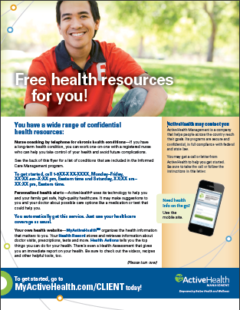
MyActiveHealth
Offers coaching services as part of the COVA health and wellness program
Available for COVA Care, COVA HealthAware and COVA HDHP members
Partners with Anthem and Aetna to deliver services promoting healthy lifestyles and chronic condition management
April 2018
Notes:
COVA Care, COVA HealthAware and COVA HDHP have something else in common for you as a member. It’s the MyActiveHealth program for helping you improve your health.
MyActive Health provides coaching services for members, and partners with Anthem and Aetna to deliver services that promote healthy lifestyles and help you manage chronic conditions.

Slide 30
MyActiveHealth Portal
All eligible adult members may access their own customized portal
Complete health assessment
Portal is enhanced with online coaching and web tools
Digital coaching
Interactive trackers, games and more
www.myactivehealth.com/cova
April 2018
Notes:
MyActiveHealth includes a web portal that is customized for each participant, spouse and dependents. All eligible adult members may access the portal, complete their individual health assessment and obtain a physician results form to submit their biometric screening.
Plus you receive enhanced online coaching and web tools for tracking your health, like interactive trackers and games.
All individual information is confidential.

Slide 31
MyActiveHealth Programs
Healthy Lifestyles - Lifestyle Coaching with Five Tracks
Smoking Cessation
Weight Management
Stress Management
Nutrition
Exercise
Healthy Beginnings - Maternity Care
Healthy Insights - Disease and Chronic Condition Management for Conditions Such As:
Heart Disease
Diabetes
Asthma/COPD
www.myactivehealth.com/cova
April 2018
Notes:
MyActiveHealth includes programs at no additional cost to you. Healthy Lifestyles provides lifestyle coaching on smoking cessation, weight management, stress management, nutrition and exercise.
Healthy Beginnings helps foster healthy pregnancies.
The Healthy Insights program helps you manage chronic conditions like heart disease or diabetes.

Slide 32
Incentives for COVA Care and COVA HealthAware
Healthy Insights
Diabetes management
Hypertension
COPD & Asthma
Healthy Beginnings for expectant moms
www.myactivehealth.com/cova
April 2018
Notes:
The Healthy Insights program has some special incentives for members of COVA Care or COVA HealthAware.
When requirements are met, it provides for certain free diabetes drugs and supplies, and certain free prescription drugs for hypertension, COPD and asthma . For Healthy Beginnings, expectant moms can qualify for a copay waiver or an HRA contribution if they enroll within the first 16 weeks of pregnancy.

Slide 33
Kaiser Permanente HMO
Available in Northern Virginia, Fredericksburg and
other cities and counties
All care coordinated by your primary care physician
Employee Assistance Program (EAP)
Online Doctor: Video Chat
http://my.kp.org/commonwealthofvirginia/
April 2018
Notes:
Now let’s move on to the Commonwealth’s regional plan…the Kaiser Permanente HMO.
The Kaiser plan is offered primarily in Northern Virginia and the Fredericksburg area. You can enroll in Kaiser if you live or work within the service area.
The Kaiser Permanente HMO has no deductible for in-network services, but you must use Kaiser HMO participating providers (except in an emergency) and choose a PCP for each enrolled family member. There is no out-of-network benefit.
Like the other plans, Kaiser offers an Employee Assistance Program, or E-A-P, and an online doctor. Video Chat is available 24/7 at no extra cost.
If you have questions about eligibility for the Kaiser plan, and specific plan benefits, contact Kaiser directly.

Slide 34
TRICARE Supplement
Voluntary supplemental health benefit option
Available to state employees and non-Medicare eligible retirees who are military retirees, or the spouse of a military retiree. They must be eligible for:
TRICARE, the military health benefits program, and
The state health benefits program
Eligible employees who enroll in the plan are responsible for 100% of the monthly premium amounts
Monthly premium payments are made with pre-tax dollars through payroll deduction
http://www.selmantricareresource.com/cova
1-800-638-2610, press Option 1
April 2018
Notes:
The final plan we will highlight is the TRICARE Supplement administered by Selman & Company.
The TRICARE supplement coordinates with federal TRICARE benefits.
You and your dependents may participate in the TRICARE Supplement if you are eligible for the state health benefits program and TRICARE as a military retiree, or the spouse of a military retiree.
One note: you cannot be eligible for Medicare.
If you enroll, you are responsible for paying 100 percent of the monthly premium. And active employees pay with pre-tax dollars through payroll deduction.
Please note that the TRICARE supplement has a new telephone number for assistance – call 800-638-2610, and select Option 1. The website is http://www.selmantricareresource.com/cova.

Slide 35
Flexible Spending Accounts (FSAs)
Health Care FSA
Set aside up to $2,600 per year, pre-tax, for eligible health care expenses
Dependent Care FSA
Set aside up to $5,000 per year, pre-tax, for eligible expenses for the care of your dependent
Administered by Anthem for all employees eligible for health care
April 2018
Notes:
The Flexible Spending Account, or F-S-A, is available to state employees eligible for the state health benefits program. It is not available to retirees.
The F-S-A is a great way to save money before taxes. It allows you to set aside funds from your paycheck, pre-tax, to cover eligible expenses. On average, an F-S-A saves you about $30 on every $100 spent on things you may already be paying for out of your pocket, like copays, deductibles and coinsurance.
It’s important to plan F-S-A spending carefully because you can’t carry over funds from year to year.
The Health F-S-A will let you set aside up to $2,600 in pre-tax dollars to pay for eligible health expenses. With the Health F-S-A you’ll receive a convenient benefit card that you can use instead of paying out of your pocket at the point of service.
The Dependent Care F-S-A lets you set aside up to $5,000 in pre-tax dollars per year to pay for eligible expenses for the care of your dependent.

Slide 36
Important FSA Information
You must enroll each plan year to participate
“Use it or lose it” rule:
Use all of your funds by the end of your coverage period
File for reimbursement by the filing deadline or forfeit your FSA funds
If you enroll in COVA HealthAware, the HRA pays first
Get information before enrolling
Go to anthem.com/cova and select Benefits tab, FSA for:
2018 FSA Sourcebook
FAQs
Calculators
Once enrolled:
Register online at www.benefitadminsolutions.com/anthem
April 2018
Notes:
You need to enroll each year to have an FSA. And remember that you may lose funds at the end of your coverage period if you haven’t filed for reimbursement by the plan’s deadline. Members in COVA HealthAware should calculate their FSA contributions carefully, since the HRA will pay first for certain expenses.
Employees who are not enrolled in an F-S-A can go to www.anthem.com/cova to learn more. You can use the online calculators to help estimate how much money to put aside in your account. Download the 2016 FSA Sourcebook and take a look at the FAQs for both the Health and Dependent Care accounts.
Starting July 1, new participants can register on the F-S-A site and start an online account to view account balances, account activity, direct deposit and online payments.

Slide 37
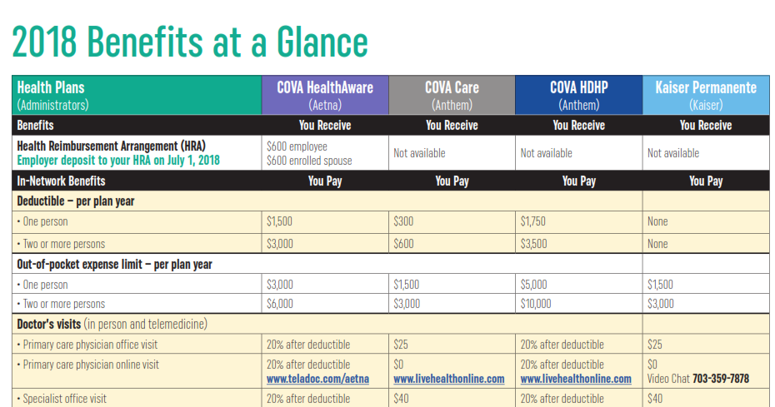
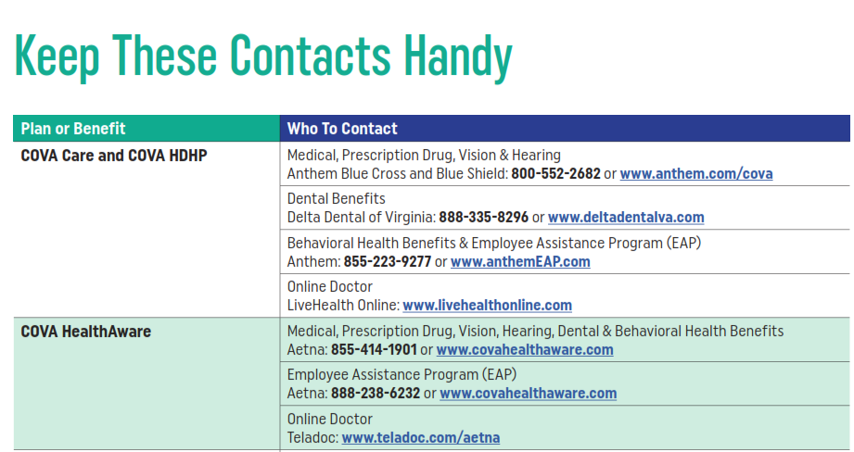
More Open Enrollment Details
Spotlight on Your Benefits newsletter or Retiree Notification booklet for:
Comparison of Benefits
Premiums & Premium Rewards
Who to contact for assistance
Your Benefits Administrator
The health plans
www.dhrm.virginia.gov
April 2018
Notes:
Here’s where to get more information…
In your Spotlight or retiree Open Enrollment booklet
From your agency Benefits Administrator
You can contact the plans or you can visit www.dhrm.virginia.gov.

Slide 38
Make Your Election!
Open Enrollment Ends May 15!
Submit an enrollment form to your agency benefits office
Employee forms must be received by the close of business on May 15
Retiree forms must be postmarked no later than May 15
April 2018
Notes:
We’ve looked at the plans, your choices during Open Enrollment and the changes this year. So once you decide the best course for you and your family, make your election!
Submit an enrollment form to your agency Benefits Administrator. Remember, Open Enrollment ends May 15th, so act now!

